Slide 1

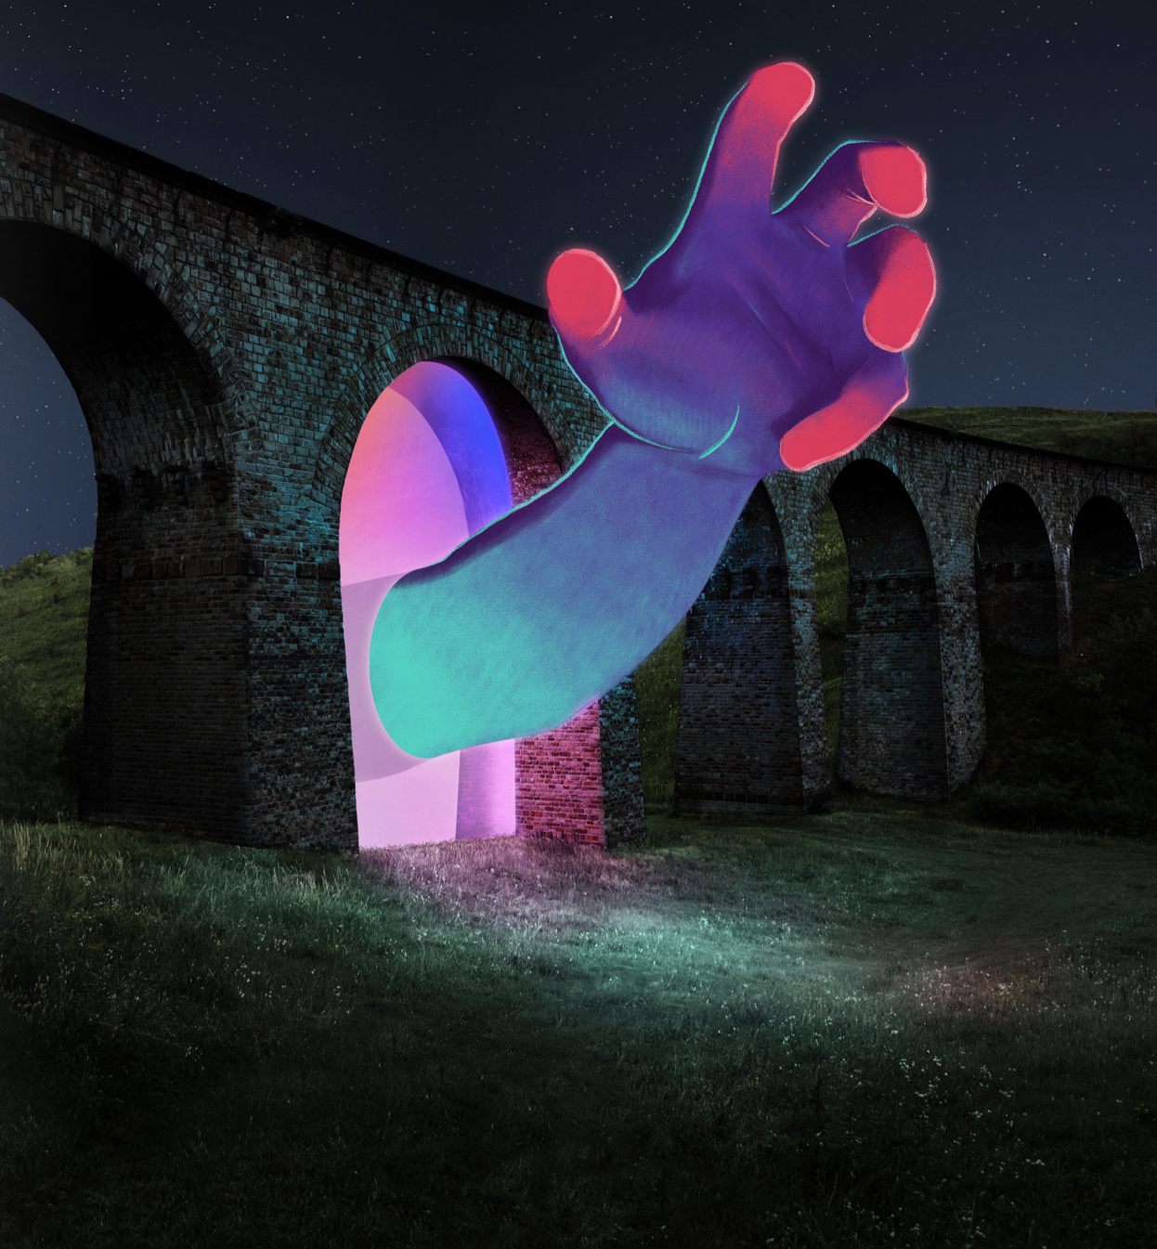

SOUTH.N Vehicle Rental Application
WORKED BY: KRISTI SAMARA
ENGJELL ABAZAJ
INDRIT FERATI

Slide 2
JOB DESCRIPTIONS
KRISTI | TASK SPLITTING, RESPONSIBLE FOR CLIENT OPERATIONS (ADDING CLIENT, DISPLAYING THE CLIENTS WHO HAVE RENTED MORE THAN X TIMES, AVAILABLE VEHICLES,DISPLAYING VEHICLES AVAILABLE AFTER X DAYS)
ENGJELL | RESPONSIBLE FOR VEHICLE OPERATIONS(ADDING NEW VEHICLES, DELETING VEHICLES, DISPLAYING VEHICLE INFORMATION, SEARCHING FOR A VEHICLE, SORTING VEHICLES BY THEIR DAILY PRICE)
INDRIT | RESPONSIBLE FOR RESERVATION OPERATIONS(CREATING RESERVATIONS, DELETING RESERVATIONS, DISPLAYING RESERVATIONS, SAVING RESERVATIONS WITH TOTAL COST EXCEEDING X TO A NEW FILE, PRICING OF THE RESERVATIONS )

Slide 3

STRONG POINTS OF OUR TEAM
1. COLLABORATION: WE HAVE A STRONG SENSE OF TEAMWORK, AND WE COMMUNICATE EFFECTIVELY TO MAKE SURE THAT OUR PROJECT WORKS PROPERLY 2. COMPETENCE: EACH MEMBER IS COMPETENT IN THEIR RESPECTIVE DOMAINS, ENSURING HIGH-QUALITY WORK

Slide 4
CHALLENGES FACED
Team management: It took considerable planning and coordination to balance individual workloads, organize duties, and ensure effective communication.
Code implementation: It was challenging to combine everybody’s work into the same program and to make sure that all the functions work properly.

Slide 5

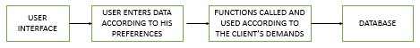

PROGRAM FLOW DIAGRAM

Slide 6
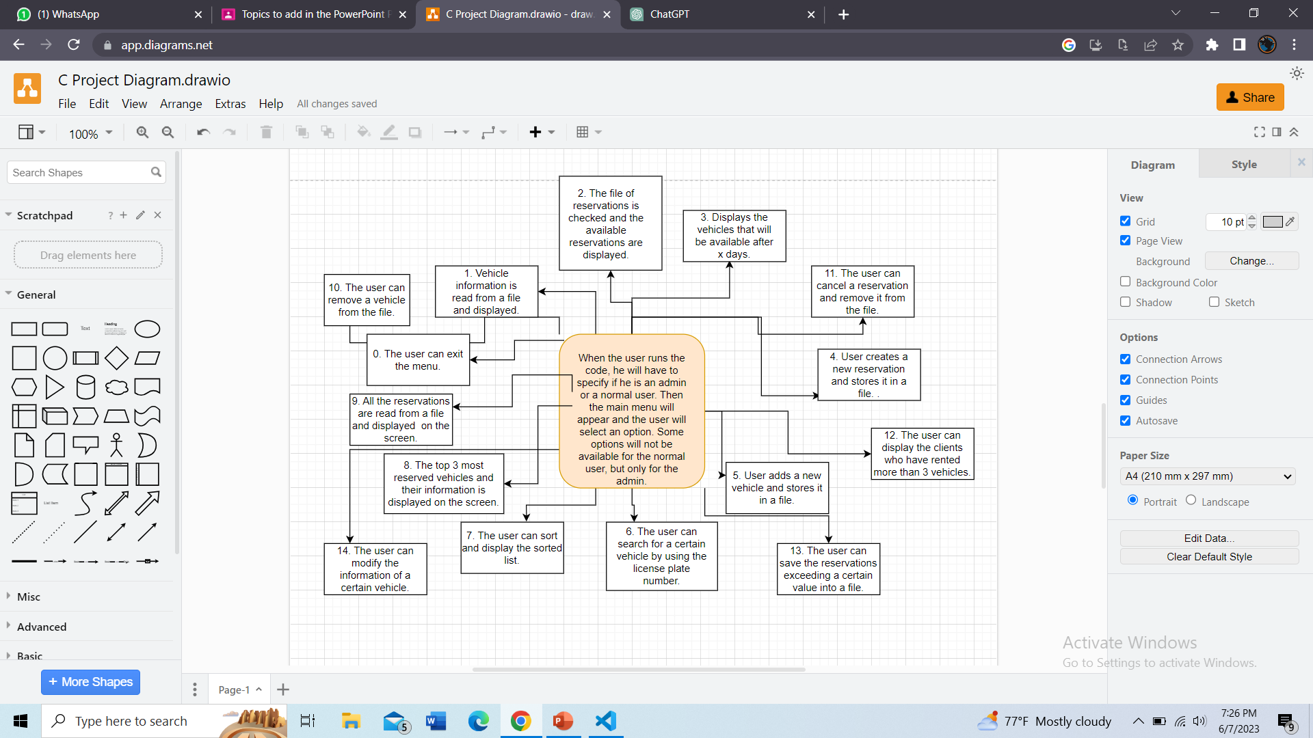

Slide 7
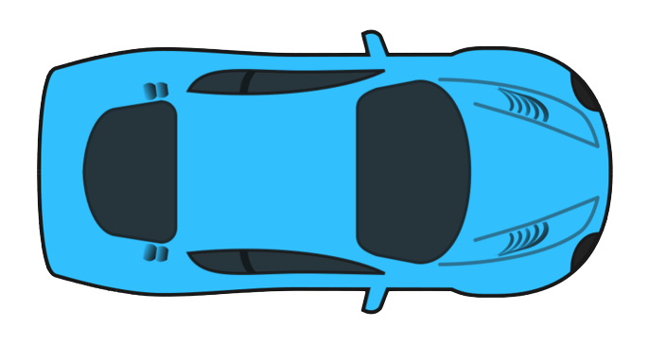
STRUCTURES
albV1: This structure is similar to Vehicle structure but it was created for the available vehicles (the ones not reserved)
Vehicle: This structure represents a vehicle and contains information such as the plate number, brand, model, year, rental price, availability, and a pointer to the next vehicle in the list.
clint: This structure represents a client and contains information such as the name, surname, ID, passport ID, state, phone number, and a pointer to the next client in the list.
reservation: This structure represents a reservation and contains information such as the plate number, client ID, rental days, price, and a pointer to the next reservation in the list.
resvV1: This structure was used for reserved vehicles

Slide 8
LINKED LISTS
CL: This linked list of type struct client is used to manage clients. Each node in the list represents a client and contains client information along with a pointer to the next client in the list.
struct Vehicle *vhead: This pointer points to the head of the linked list of vehicles. Each node in the list represents a vehicle and contains vehicle information along with a pointer to the next vehicle in the list.
struct reservation *head1: This pointer points to the head of the linked list of reservations. Each node in the list represents a reservation and contains reservation information along with a pointer to the next reservation in the list.
resvV *head2: This pointer points to the head of the linked list of additional rental information. Each node in the list represents additional information about rentals and contains information about the brand, model, and the number of times a vehicle has been rented.
struct reservation *head3: This pointer points to the head of another linked list of reservations. It is used in one of the menu options to manage reservations separately.

Slide 9
RELATIONSHIPS
The CL linked list of clients (head) is managed using the struct client structure. Each node in the CL list represents a client and contains client information along with a pointer to the next client.
The struct Vehicle structure is used to create a linked list of vehicles (vhead). Each node in the list represents a vehicle and contains vehicle information along with a pointer to the next vehicle.
The struct reservation structure is used to create a linked list of reservations (head1, head3). Each node in the list represents a reservation and contains reservation information along with a pointer to the next reservation.
The resvV linked list (head2) contains additional rental information and is separate from the main vehicle and reservation structures. It is used to store information about the number of times a vehicle has been rented.

Slide 10
EXTRA FEATURES
The extra feature of our program is that the main menu is split between the admin and a normal user. There are certain operations which can be performed by the admin only and the code will not let the average user access them, but will politely ask him to choose another option or exit the menu.

Slide 11

WHY SHOULD YOU BUY OUR SOFTWARE?
User-friendly: Thanks to our program’s simple user interface, consumers can rent automobiles with ease.
Efficiency: Our program makes sure users select the best vehicle in the easiest and fastest way, saving them time and energy.
Fast and Dependable: One of our project’s goals was to be built for maximum performance that guarantees quick responses.

Slide 12

THANK YOU FOR YOUR ATTENTION!

